Slide 1
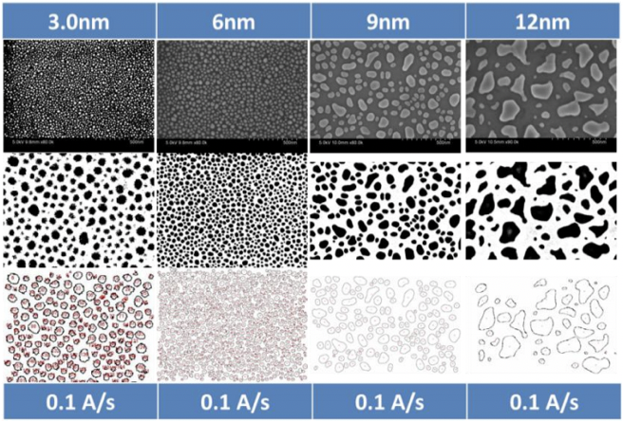

AI Image Analysis for Nanotechnology ——Project Application for SRTP
Advisor Prof Huan Hu
Prof Mark D.Butala
Student Jieting Chen
Yiqun Niu
Yue Feng

Slide 2
Introduction of Project Team
Advisor
1. Hu Huan, assistant professor
Expertise in Micro/nanomanufacturing and biomimetic sensors and micro/nanofluidics
2. Butala D.Mark, assistant professor
Expertise in image reconstruction and tomography statistical signal and image processing theory and application
Student
1. Chen Jieting, ECE sophomore of ZJUI
Have participated in the research project of music emotional light effect system.
2. Niu Yiqun, ECE sophomore of ZJUI
Have participated in a research project on microstrip.
3. Feng Yue, ME sophomore of ZJUI
Have participated in the research project of the biped robot.
Project
First step: use atomic force microscope to obtain the samples images of nanoparticles
Second step: develop a basic artificial intelligence algorithm to improve the efficiency of image analysis

Slide 3
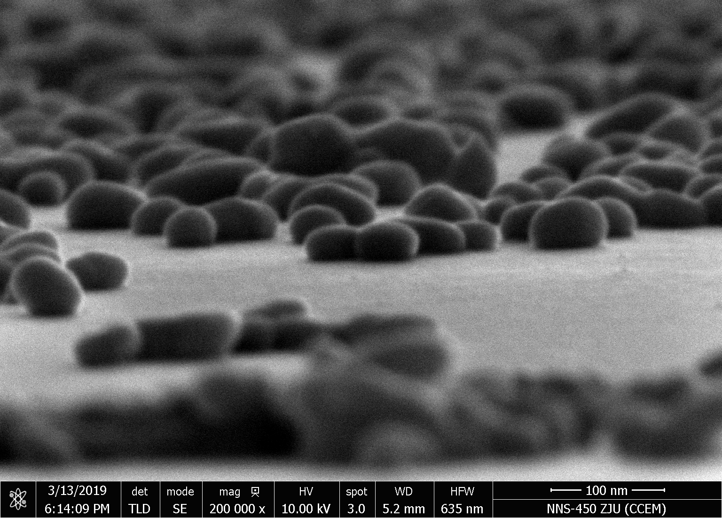
1. Project Background and Purpose
2. Research Details
3. Project Plan
4. Creative Ideas
5. Excepted Achievement

Slide 4
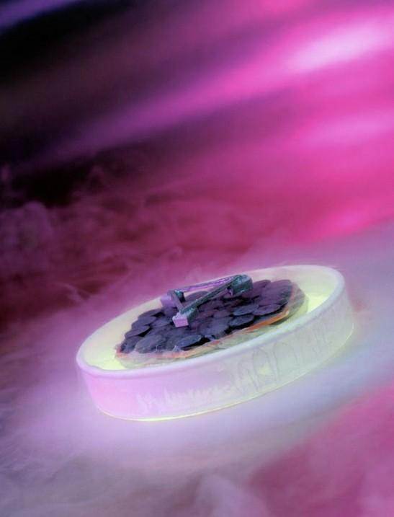
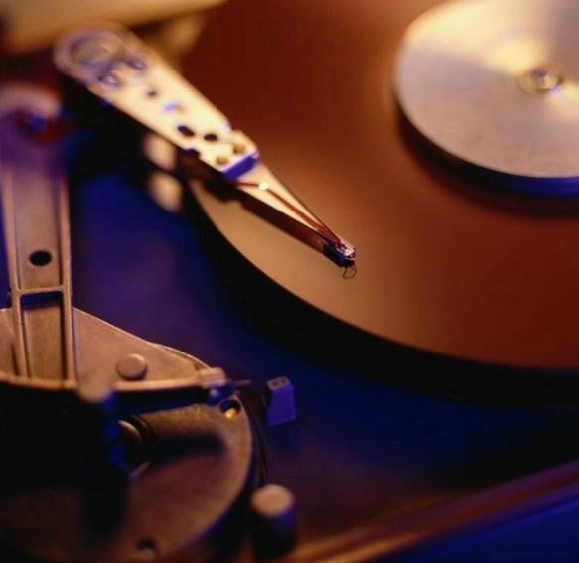
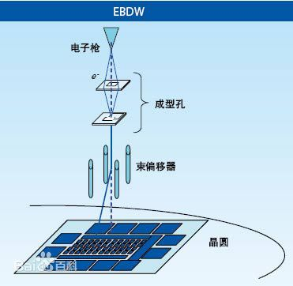
Project Background and Purpose
Background
Two existed methods to large scale fabrication of structures to 100 nanometers
Deep ultraviolet lithography disadvantage: The technology is expensive and can only be used to make semiconductor chips
Electron beam lithography disadvantage: The technology is slow, can not be widely manufactured, and the cost is high, it is difficult to widely used

Slide 5
Project Background and Purpose
Purpose
explore a low-cost nanofabrication technology to produce silver nanoparticles by heating silver films
BUT
what‘s the connection between the purpose and our project???
AI analysis technology →
The ability to batch processing of nanoparticles images →
Improve the efficiency to analyze process parameters →
Find out the best conditions to produce silver nanoparticles template →
Apply the template to produce large scale fabrication of structures to 100 nanometers →
Make the purpose(or called the third method) practical and apply them in different aspects

Slide 6
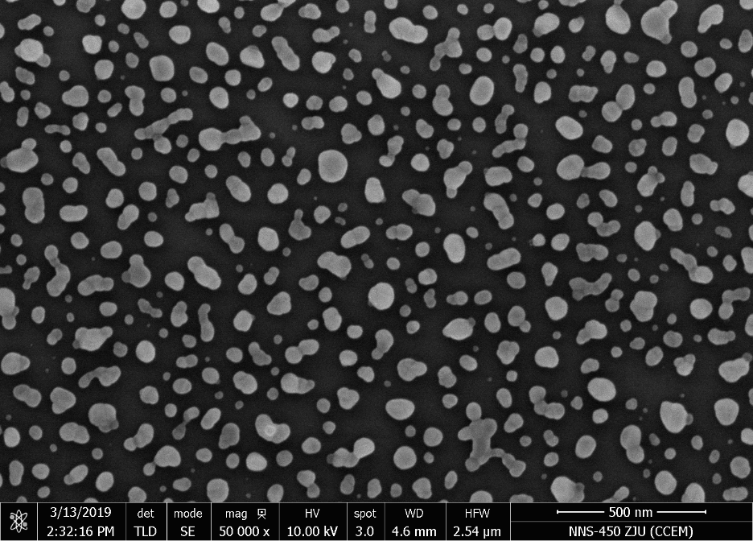
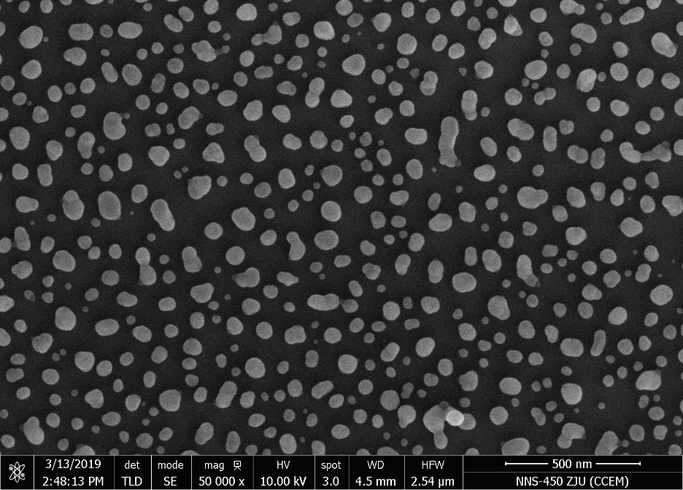
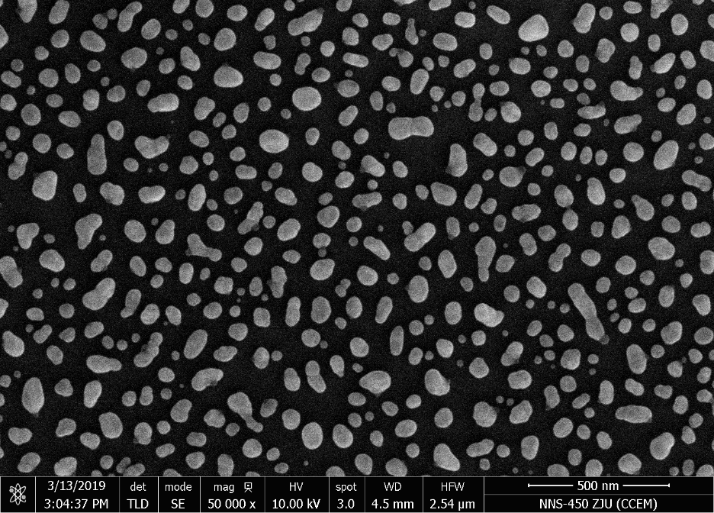
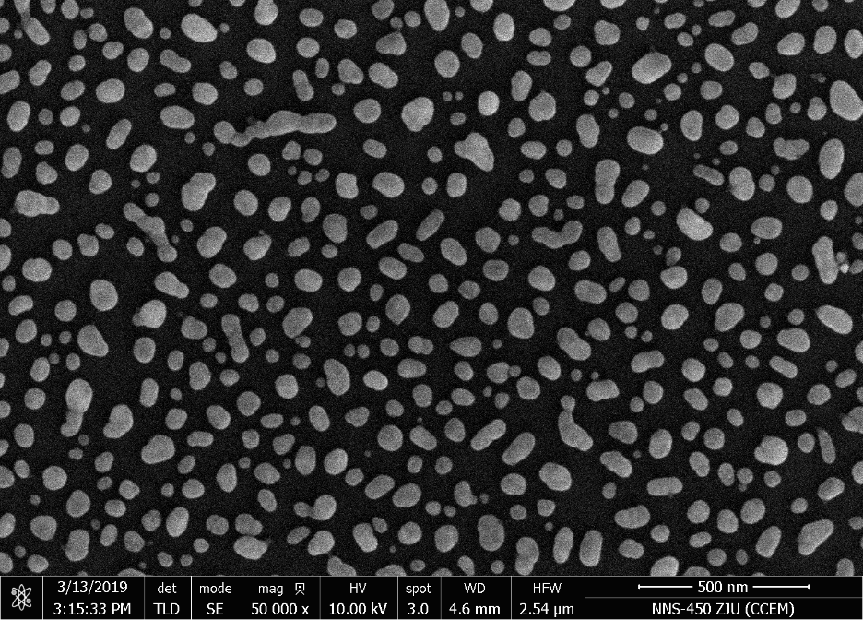
Different Temperature RTP (SEM 50000 x)
10 nm Ag
120℃ 10min
10 nm Ag
240℃ 10min
10 nm Ag
360℃ 10min
10 nm Ag
480℃ 10min

Slide 7
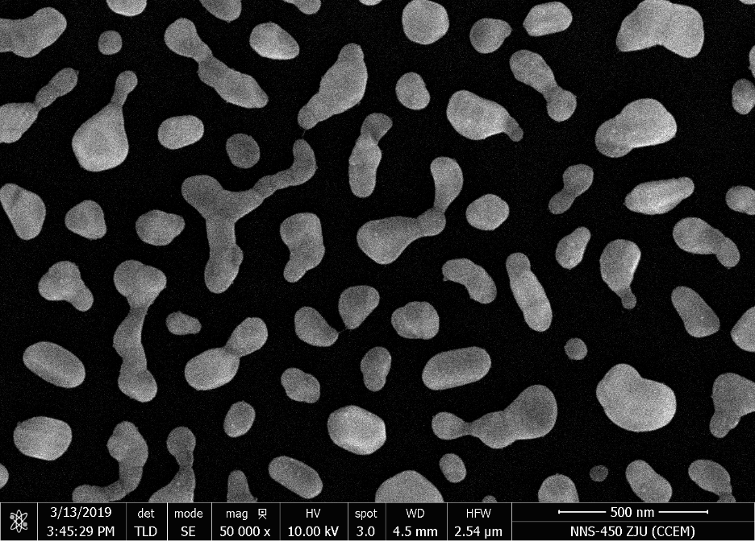
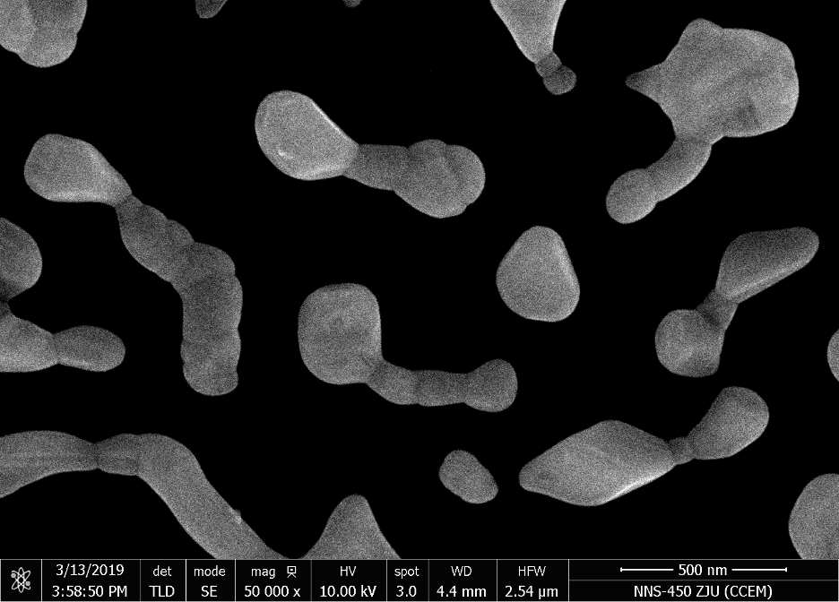
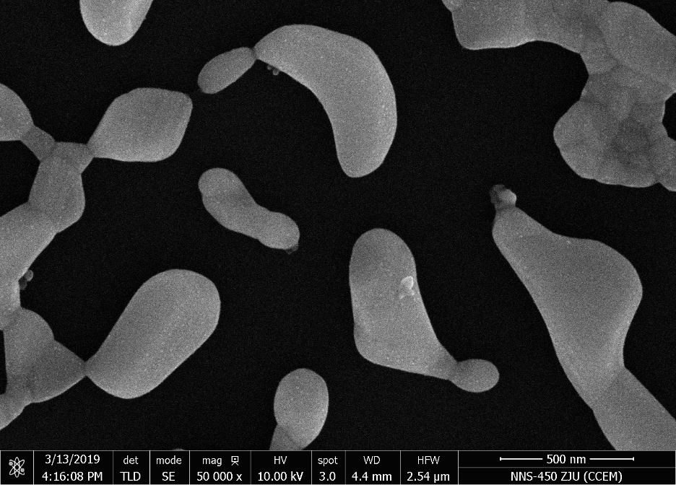
Different Thickness Silver (SEM 50000 x)
10 nm Ag
480℃ 10min
20 nm Ag
480℃ 10min
30 nm Ag
480℃ 10min
40 nm Ag
480℃ 10min

Slide 8
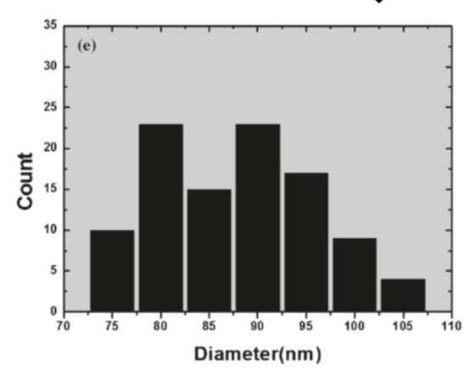
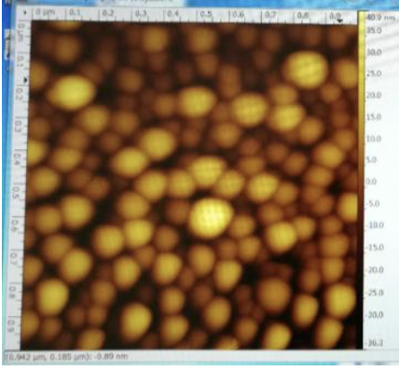
Research Details
1. Use atomic force microscope (AFM) to measure the samples of nanoparticles and scan the samples to obtain the morphological images of nanoparticles.
2. Use image analysis technology to process the images to obtain the size and number of nanoparticles, and the histogram of nanoparticles
3. Between above-mentioned two steps, a basic artificial intelligence algorithm program was developed to improve the efficiency of image analysis
the original method of utilization of open source software ImageJ
→
the batch processing of nano-particle images by artificial intelligence algorithm
First step
obtain the morphological images of nanoparticles.
Second step
Obtain the histogram of
nanoparticles

Slide 9
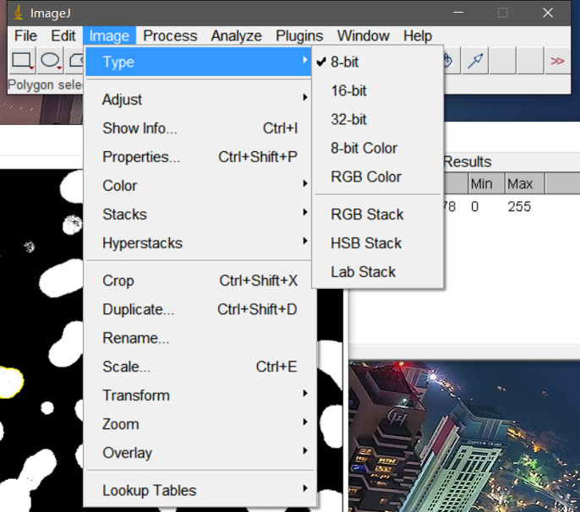
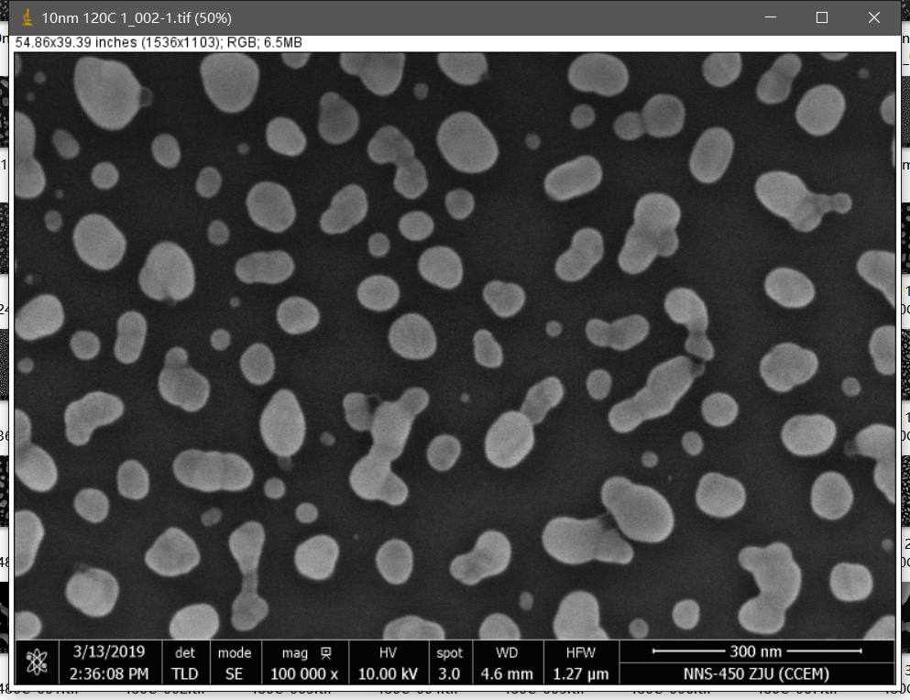
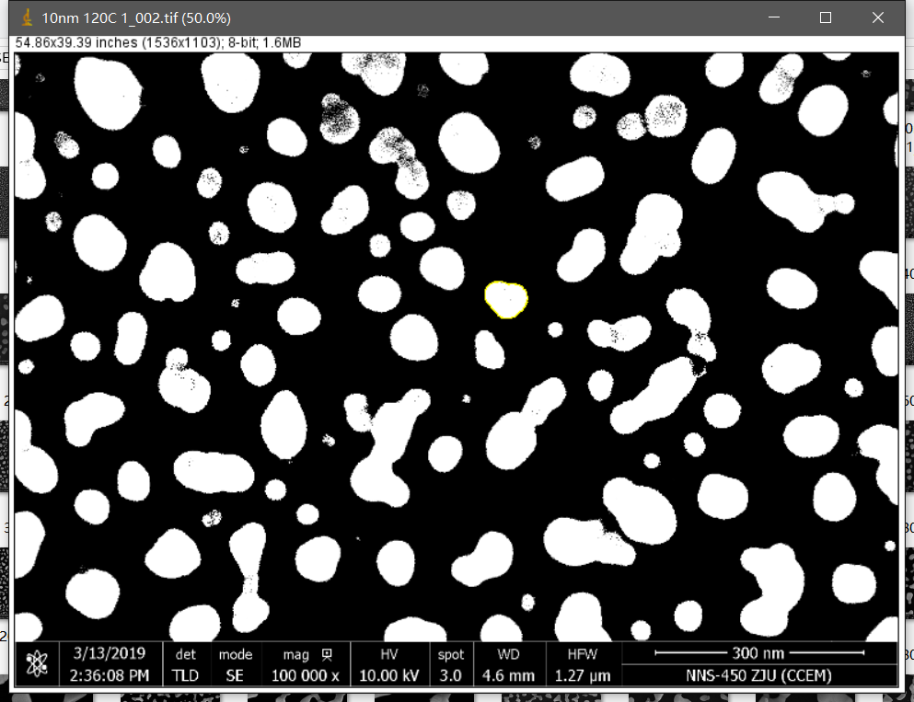

Slide 10
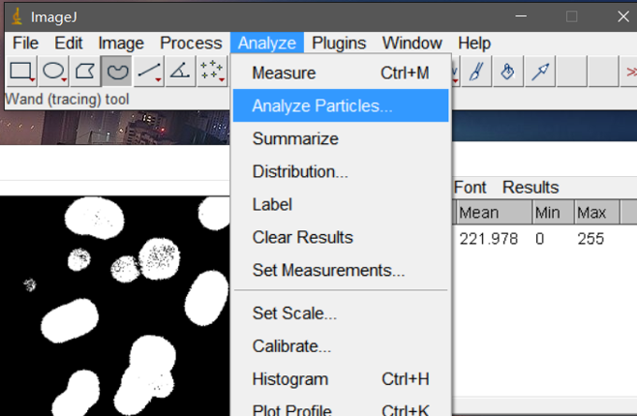
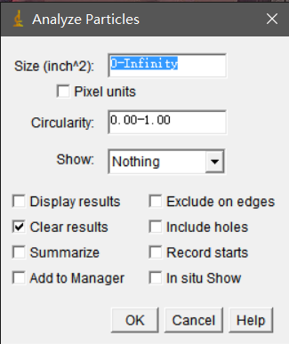

Slide 11
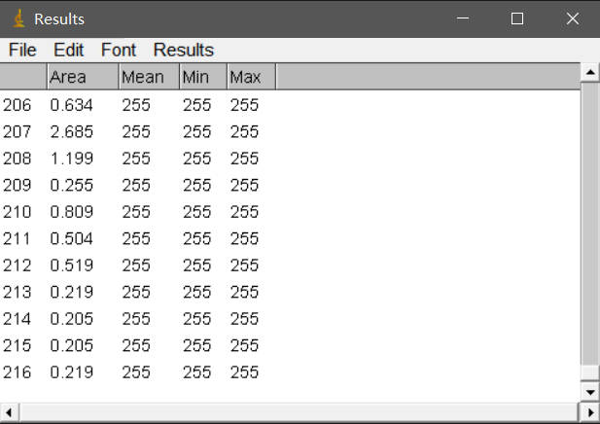
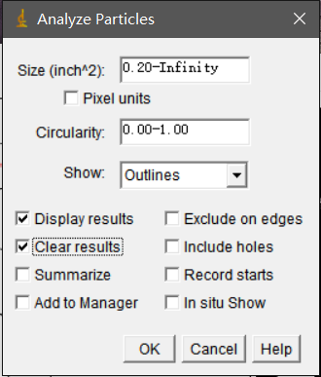
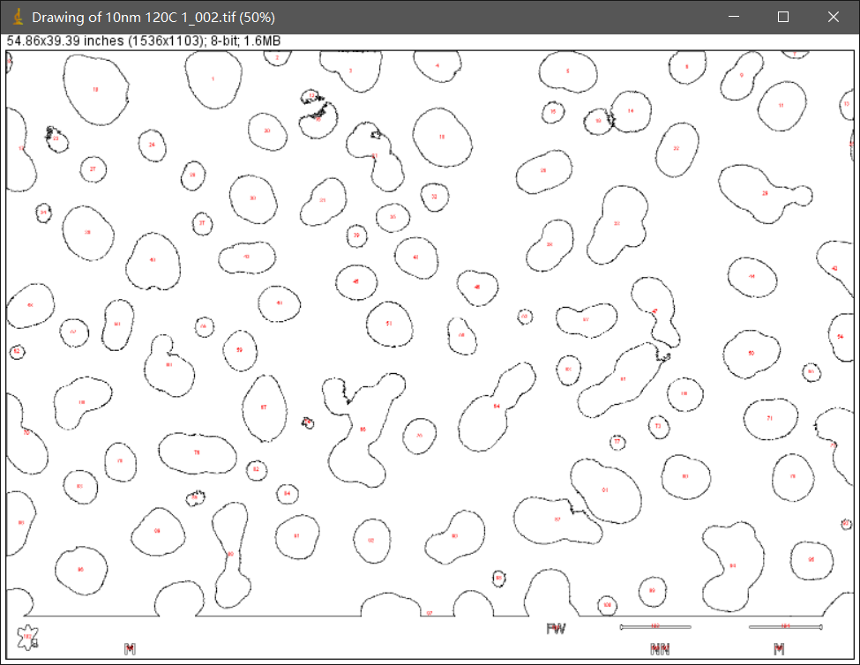

Slide 12
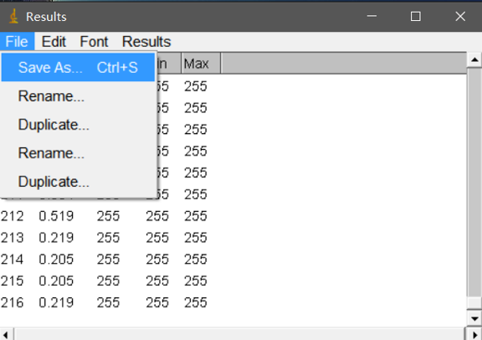

Slide 13
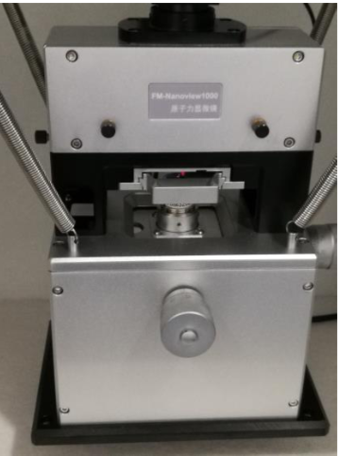
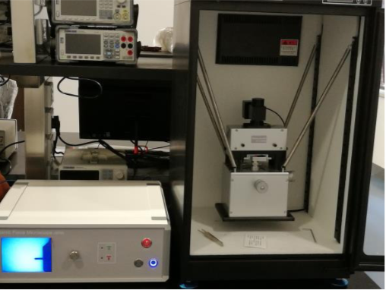
Project Plan
2019.3—2019.6
Practice to use FM-Nanoview 1000AFM proficiently
Learn to use ImageJ to process Nano-particle image manually.
2019.6—2019.9
Practice to be familiar with image processing software and technology
2019.9—2019.12
Develop AI image processing technology, explore various algorithms, design and manufacture plug-in with appropriate algorithms
2020.1—2020.3
Write journal article
Participate in national conference

Slide 14
Creative Ideas
BIG IDEA: the new method to large scale fabrication of structures to 100 nanometers (for the purpose of cost reduction)
Using AI algorithm to facilitate the processing of Nano-structure image on a large scale instead of using ImageJ to process Nano-particle image manually.
Reduce the cost and time to carry out experiments and explore the proper condition and manufacture nano-structure

Slide 15
Expected Achievement
1. Developing a software or plug-in which can improve the efficiency of Nano-image processing
2. Participating in conference or public journal articles.
3. Using the developed software of plug-in to get valuable data, which can lead to find the optimal technological parameters. In this way, it can improve the development of Nano-manufacturing technology in low cost and large scale.

Slide 16
谢谢

